Slide 1
National Day
Spiritual Protection Wall
Board Game
Image Credit : Singapore Global Network, https://www.cpsctech.org/2024/08/singapore-renews-commitment-to-its.html

Slide 2
1) Pray for our country’s peace and prosperity
Jeremiah 29:7 - Also, seek the peace and prosperity of the city to which I have carried you into exile. Pray to the LORD for it, because if it prospers, you too will prosper.
2) Pray for our government leaders
Proverbs 2:1-8 - My son, if you accept my words and store up my commands within you, 2) turning your ear to wisdom and applying your heart to understanding— 3) indeed, if you call out for insight and cry aloud for understanding, 4) and if you look for it as for silver and search for it as for hidden treasure, 5) then you will understand the fear of the LORD and find the knowledge of God. 6) For the LORD gives wisdom; from his mouth come knowledge and understanding. 7) He holds success in store for the upright, he is a shield to those whose walk is blameless, 8) for he guards the course of the just and protects the way of his faithful ones.

Slide 3
Do you know our country’s leaders?
See this list to know who they are!
https://www.pmo.gov.sg/The-Cabinet

Slide 4
Areas We Can Pray for our country
No. | Social Groups | What you can pray for
1 | Children and Youths | Stress in school, cyber-addiction, physical and mental health, good values, relationship with parents, friendship struggles etc.
2 | Parents | Work-life harmony, wisdom to teach children well, financial stability etc.
3 | Singles | Work-life harmony, wisdom in finding marriage partner, having a sense of purpose in life etc.
4 | Elderly | Health, relationship with family, having meaning and purpose in life etc.
5 | Foreigners | Well-integrated into Singapore, well-taken care of by bosses, not to spread negative views that hurt our community’s values etc.
6 | Various racial groups | Harmony, unity, no discrimination in the workplace or school etc.
7 | Disabled/ people with special needs | Singapore can meet their needs, enough schools for children with special needs, their parents to have enough care-giving support
8 | Non-Christians | That all Christians actively share the love of Christ with them and let them find joy and purpose in life.

Slide 5
Areas We Can Pray for our country
No. | Country Specific | What you can pray for
1 | Military and Civil Defense | Strong army, navy, air force and police force.
2 | Economy | Enough good jobs for all, wisdom in political and industry leaders to grow our economy.
3 | Land Use | Wise and effective land use, good transport network, good infrastructure etc.
4 | Water Supply | We can increase our own water supply, reduce use and wastage of water etc.
5 | Environment and Climate | Citizens actively adopt ways to save the earth, slowing down pollution’s negative impact on climate, more innovations to cope with high heat and harsh storms etc.

Slide 6
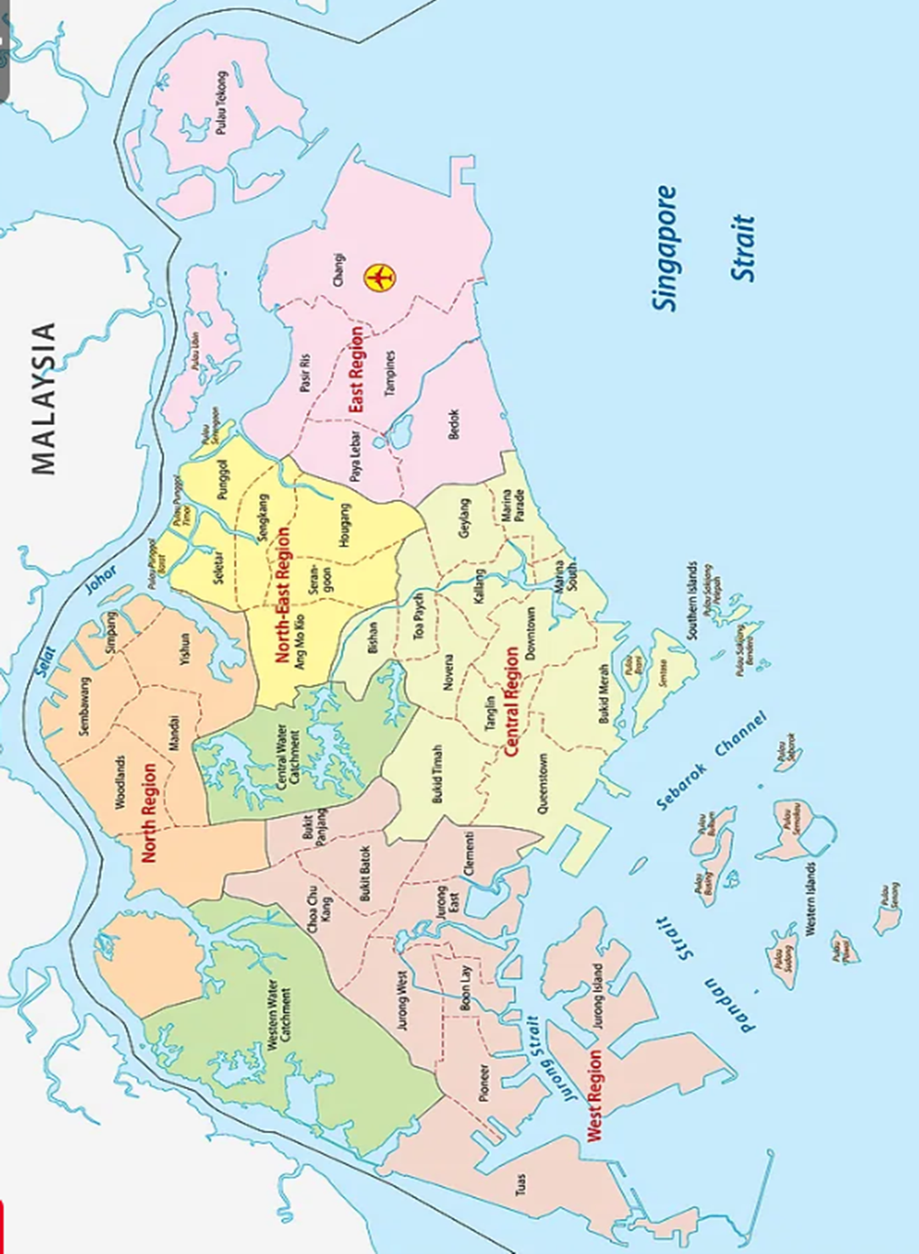
Print out A3 sized Country Map
- place bricks earned at the border of the map. To win, children must surround the border at the end of 30mins.
Image Credit- https://www.worldatlas.com/maps/singapore

Slide 8
National Crisis! - reveal only when children lands on this in the board game.
POSSIBILITIES (or create your own)
A pandemic hits. Pray for healthcare professionals to handle the stress of caring for the sick, doctors and scientists to find the cure, government leaders make wise decisions to bring the pandemic under control.
Natural disaster strikes! Floods destroy many properties. Pray for the rain to stop. Pray for good measures to save properties and curb the flood waters.
Economic downturn! Many people lost jobs. Pray for government and industry leaders to make wise decisions to protect the economy, save people’s properties and jobs.
Your country experiences a racial conflict! Pray for wisdom for all involved to calm down, resolve differences and misunderstandings peacefully. Pray against misinformation and extremist views in the country.

